Slide 1
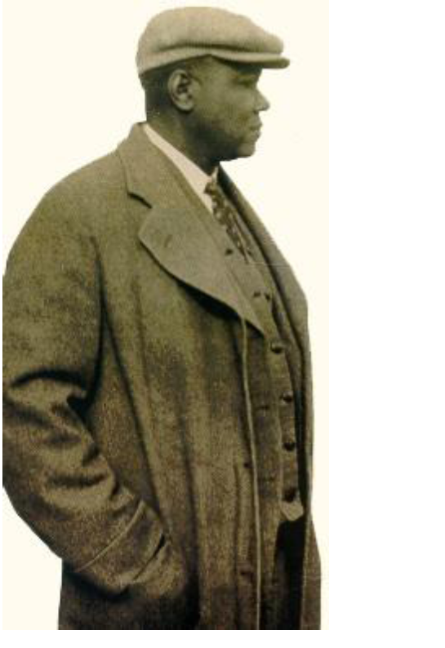
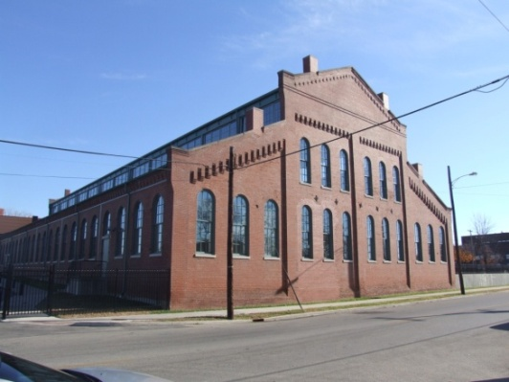
Environmental Justice/Ladders of Opportunity; The Samuel Plato Academy for Historic Preservation Trades
Notes:
Presentation on the implementation of the Minority Historic Craftsman Training Program
-A project enhancement committed to in the Record of Decision for the Louisville-Southern Indiana Ohio River Bridges Project

Slide 2
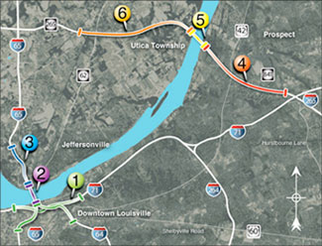
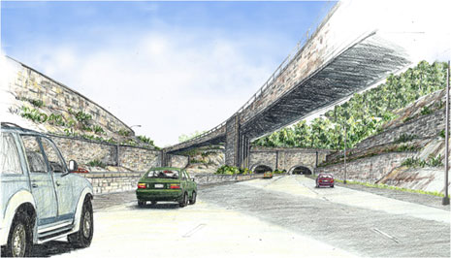
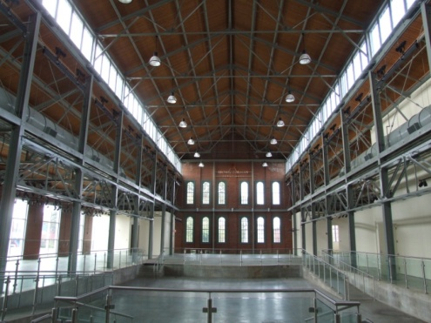
Louisville-Southern Indiana Ohio River Bridges Project Louisville, Kentucky & Southern Indiana
Notes:
As a refresher…
The LSIORB is the $2.3 Billion mega project in the Louisville/Southern Indiana region constructing two new bridges over the Ohio River about 8 miles apart. We’re also rebuilding the Kennedy interchange, performing major repairs on the Kennedy Bridge and building a tunnel as part of the East End Crossing approach
We’ll be wrapped up by the end of the year

Slide 3
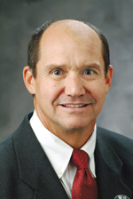
Revised 2012 Record of Decision
4.3.1 The Minority Historic Rehabilitation Craftsman Training Program will be developed and implemented in the reconstructed Trolley Barn that houses the Kentucky Center for African-American Heritage (KCAAH). The following commitments should be included in a Memorandum of Understanding (MOU) with SHPO for the development and operation of the Craftsman Training Program:
Notes:
As a mitigation for the impacts a project of this size is expected to have on the surrounding historic communities and recognizing that there is a shortage of local preservation crafts people, John Carr formerly of KYTC said “Hey, let’s commit to having a craftsman training program so we can train the workforce we need to do the work we want in the community that could really use it”.
Here it is in Section 4.3.1 of the Record of Decision…

Slide 4
1. Funding in the amount of $1,500,000 will be made available to KY SHPO to implement and operate the Craftsman Training Program with the requirement that the program operate for a minimum of three years.
2. A Craftsman Training Board consisting of volunteers familiar with craftsman training and/or DBE initiatives shall be appointed to oversee and make recommendations to the SHPO and/or a Bridges Project DBE Committee. The Board will be responsible for the operation of the program, which will include hiring of staff, the purchase of equipment and tools for the training, and the development of a curriculum.
3. The Craftsman Training Board will also be responsible for determination of the proper expenditure of the $1,500,000. The Board will develop a plan for these expenditures and will make recommendations for how the program could be sustained beyond this initial investment from KYTC. The recommendation will identify availability of future funding from other sources beyond the $1,500,000 maximum provided by KYTC.
4. All materials, tools and equipment purchased with mitigation funds to support the Craftsman Training Program may be purchased at salvage value by the Kentucky Heritage Council at the conclusion of the three-year mitigation commitment or returned to the Federal Highway Administration.
5. The Craftsman Training Board will recommend a person to serve as an Executive Director, which will be a paid permanent position. The Executive Director must be familiar with the trades taught in the curriculum and will serve as one of the instructors.
6. The Kentucky SHPO will provide the general oversight of the operation of the program.
Notes:
Funding is for a required 3 year period
-$1.5 million (which we’ve increased in order to pull this off)
-Held in Building C of the Trolley Barn/Kentucky Center for African American Heritage
-Equipment was purchased as part of this effort
Goal is to introduce west end louisvillians to the historic restoration trade, sparking a desire in them to take on the numerous opportunities that area has for historic restoration.

Slide 5
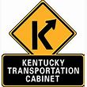
Notes:
We have many partners in this undertaking:
-Kentucky Heritage Council and the State Historic Preservation Officer
-Louisville Metro Housing
-Kentucky Center for African American Heritage
-KCTCS and JCTC

Slide 6
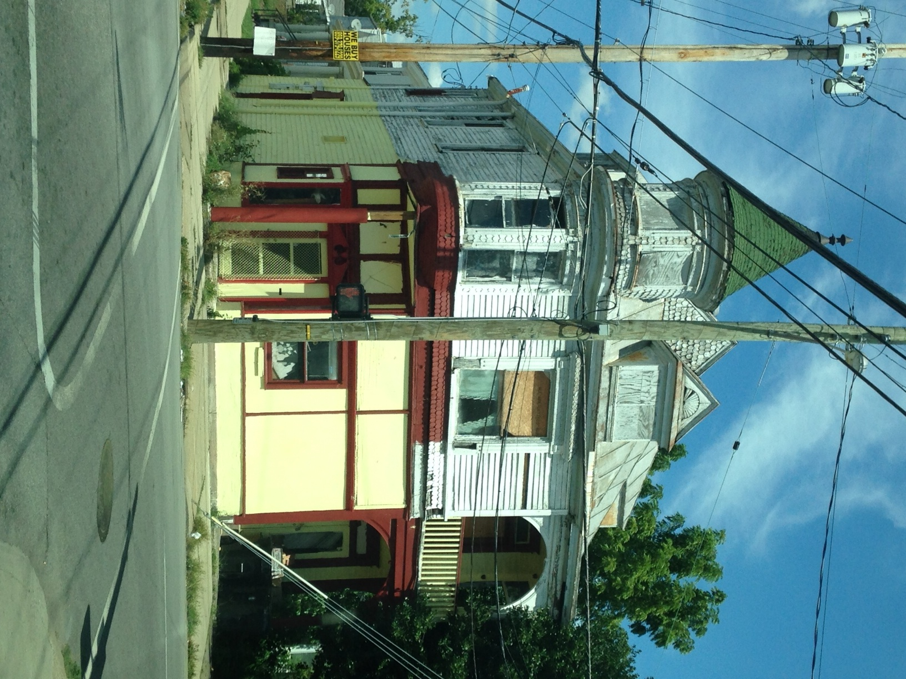
Challenges
Management
Organizational Structure
Community Engagement
Expertise
Facility
Goals – Educational
Job Creation
Community
Notes:
Certainly we have some challenges in trying to pull this off
-What the heck is a Craftsman Training Program anyway?!
-Who can tell us what one is?
-Where can we find someone to develop it?
Finding that expertise was key and that got the ball rolling
-Bob Yapp from Hannibal, Missouri provided that expertise, org structure, equipment list, facility layout and community buy-in.
-He was the linchpin.
Identifying our goals helped identify our mission
-Educate people in the historic restoration craft
-Teach them a skill that will lead to economic opportunity, a job
-Focus this as an investment in the community

Slide 7
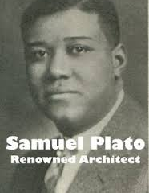
SPA Mission, Goals and Structure
The Samuel Plato Academy’s commitment is to equip its students with highly valuable skills in the historic rehabilitation and restoration trades while fostering pride, leadership, integrity and self-sufficiency. The ability to positively influence lives through historic preservation in West Louisville is our measure of success.
“My whole goal in life has been to improve and help others who come up behind me.”
-Samuel Plato (1882-1957)
Notes:
So, here is their mission
That brings us to the program’s name and namesake, Samuel Plato

Slide 8
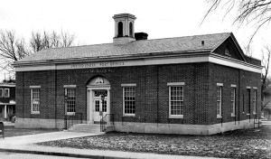
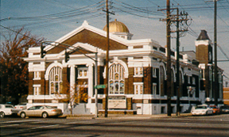
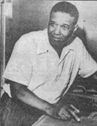
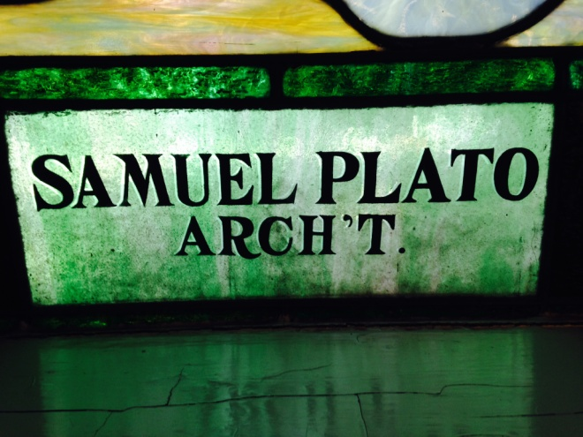
“From basement to roof, his work recommends him and needs not be pointed out as the job of a Negro, but that of a competent architect and contractor. Yes, he is an asset to his race; no, he is an asset to Louisville.”
Louisville Leader (Aug. 25, 1923)
Notes:
Samuel M. Plato (1882-1957) was a prominent African-American architect and builder who not only made important contributions to the African-American community in Louisville but also achieved national recognition for his imaginative designs elsewhere in the country. When Plato graduated from State University Normal School in Louisville in 1902 and completed his mail-order program in architecture with International Correspondence Schools, he became part of a small pioneering African-American architects who made their mark early in the last century.
He was the first African-American to be awarded a contract to build a post office, and he was one of only a few African-American contractors to build federal government defense housing projects during World war II.
Plato designed and built a wide variety of buildings, including Greek Revival and Craftsman-style houses, elegant mansions, post offices, banks, churches, schools, office buildings, theaters, and government housing projects. Eight of his buildings are listed on the national Register of Historic places, including the Broadway Temple A.M.E. Zion Church in Louisville

Slide 9
Notes:
We created a logo and brand for the program:
The Samuel Plato Academy of Historic Preservation Trades
-Notice the postage stamp border as call back to Plato’s work designing Post Offices

Slide 10
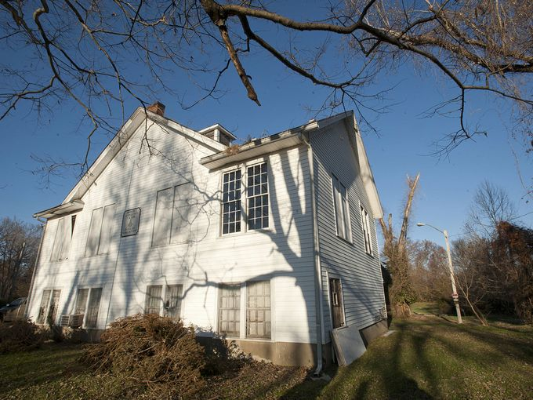
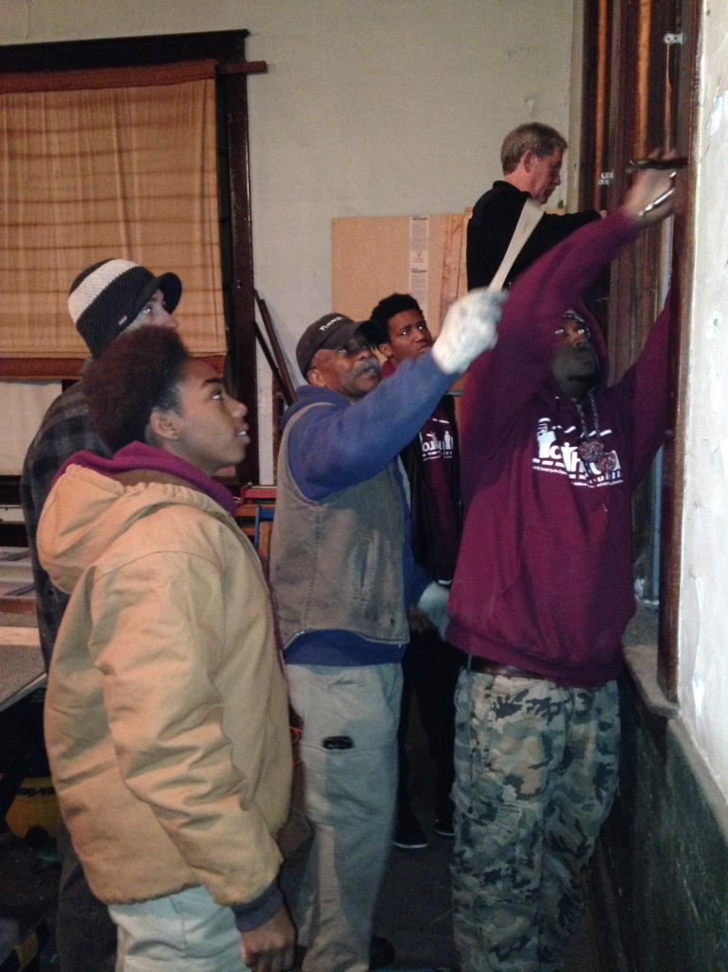
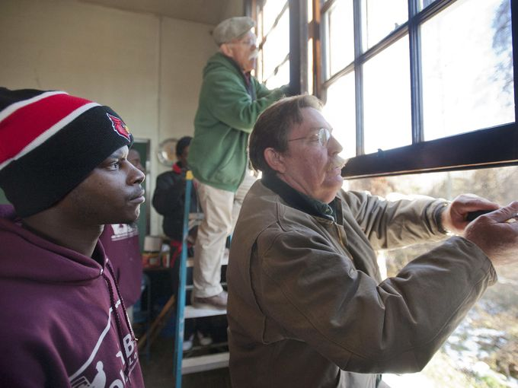
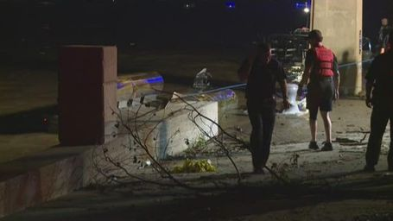
See more video
VIDEO | PONTOON BOAT CAPSIZES ON OHIO RIVER
Nine people were aboard a pontoon boat that crashed into the Second Street Bridge and capsized, killing at least 2.
1 of 36
See more video
VIDEO | MAYOR FISCHER ON POSSIBLE SALE OF HUMANA
Louisville's Mayor Greg Fischer talks about the deal for Aetna to purchase Humana.
2 of 36
See more video
VIDEO | FLEA MARKET SPECTACULAR WILL TEMPT YOUR TASTEBUDS AND WALLET
Video | Flea Market Spectacular will tempt your tastebuds and wallet
3 of 36
See more video
YMCA SAFE HOUSE PROGRAM
Markia Pence spent most of his time in and out of the YMCA Safe House. The program, which allows homeless or dislocated youth time off the streets Mon. thru Fri., has aided in him reaching for higher goals and has become like another family.
4 of 36
See more video
VIDEO | ALWATAN BAKERY HELPS REFUGEES FEEL CLOSER TO HOME
Adel Talib talks about the family bakery and how their store helps Middle Eastern refugees feel closer to home this Ramadan season.
5 of 36
See more video
VIDEO | EXPERIENCE NEW T3 ROLLER COASTER AT KENTUCKY KINGDOM
POV video: T3 (Terror to the third power) roller coaster preview.
6 of 36
See more video
VIDEO | FIREFIGHTERS BATTLE OLD LOUISVILLE APARTMENT FIRE
Just before 8 a.m. Thursday, fire crews responded to a massive house fire in the 1100 block of South 2nd Street.
7 of 36
See more video
VIDEO | RAW VIDEO FROM FATAL FIRE IN OLD LOUISVILLE
Firefighters battle the blaze in a three-story residence on South Second Street in Old Louisville.
8 of 36
See more video
U.S. AIRLINES ARE BEING INVESTIGATED FOR POSSIBLE COLLUSION
Are we paying more than we should for airline tickets? The Department of Justice is looking into that. The airlines, American (AAL), Delta (DAL), United Continental (UAL) confirmed they are part of the investigation and are cooperating. The Departmen
9 of 36
See more video
CONFEDERATE FLAG SUPPORTERS ON SITE FOR OBAMA'S VISIT
Demonstrators show off their "Southern heritage" across the street from where President Obama was speaking Wednesday in Madison, Tenn.
10 of 36
See more video
THURSDAY'S FORECAST: COLD FRONT STALLS IN THE EAST
The national weather forecast for Thursday, July 2 calls for thunderstorms in the Mid-Mississippi and Tennessee Valleys, evening thunderstorms from Virginia to New York, and the Great Plains.
11 of 36
See more video
PIGS ON PARADE AT THE NATIONAL JUNIOR SWINE ASSOCIATION EXHIBITION
What's it take to show a pig? Dedication and some love from these teens at the swine spectacular that runs through July 4 at the Kentucky state fair grounds.
12 of 36
See more video
WALMART APOLOGIZES FOR 'ISIS CAKE'
What's up with Walmart? A Louisiana man was frustrated by his local Walmart after it refused to feature an image of the Confederate flag on a cake he ordered. Testing Walmart's limits, the man then decided to ask for a cake with the ISIL flag.
13 of 36
See more video
TUESDAY'S FORECAST: STORMY FROM GREAT LAKES TO NORTHEAST
The national weather forecast for Tuesday, June 30 calls for storms from St. Louis to Detroit, thunderstorms from Louisville to Washington D.C., and showers and thunderstorms along the Gulf Coast.
14 of 36
See more video
VIDEO | REV. MAURICE "BOJANGLES" BLANCHARD AND DOMINIQUE JAMES GET MARRIAGE LICENSE
Blanchard and James were among the plaintiffs in Kentucky's gay marriage case, which ended last week with the Supreme Court ruling that same-sex couples in all 50 states have the right to marry.
15 of 36
See more video
VIDEO | GO APE ROPE COURSE AT JEFFERSONVILLE MEMORIAL FOREST
CJ reporter Kirby Adams takes you on a first look at the new Go Ape ropes course scheduled to open over the Fourth of July weekend at Jefferson Memorial Forest.
16 of 36
See more video
JOEL OSTEEN HECKLED DURING CHURCH, SIX ARRESTED
Police say six people were arrested at Houston's Lakewood Church after heckling Pastor Joel Osteen while he was preaching.
17 of 36
See more video
VIDEO | BLACK LIVES MATTER VIGIL AT FIRST UNITARIAN CHURCH
Members of the First Unitarian Church held a Black Lives Matter vigil on Sunday sponsored by the church's Women's Alliance.
18 of 36
See more video
VIDEO | LOUISVILLE GAY MARRIAGE SUPPORTERS TALK ABOUT 'LANDMARK MOMENT'
Louisville gay marriage supporters talk about a 'landmark moment' in the country's history.
19 of 36
See more video
VIDEO | THE SOUNDS OF 1200
Jecorey "1200" Arthur performed for the crowd at ReSurfaced.
20 of 36
See more video
VIDEO | NUMBER OF NEWBORNS WITH ADDICTIONS RISES IN 2015
Dealing with Kentucky's skyrocketing numbers of addicted babies.
21 of 36
See more video
RAW: GAY MARRIAGE SUPPORTERS CHEER COURT DECISION
The Supreme Court declared Friday that same-sex couples have a right to marry anywhere in the United States. (June 26)
22 of 36
See more video
West End preservation 'boot camp' planned
Notes:
With a name and mission in place, the program kicked off its inaugural year with 13 students.
-Here’s Bob Yapp conducting a preservation boot camp with Jim Turner, executive director, and some students

Slide 11
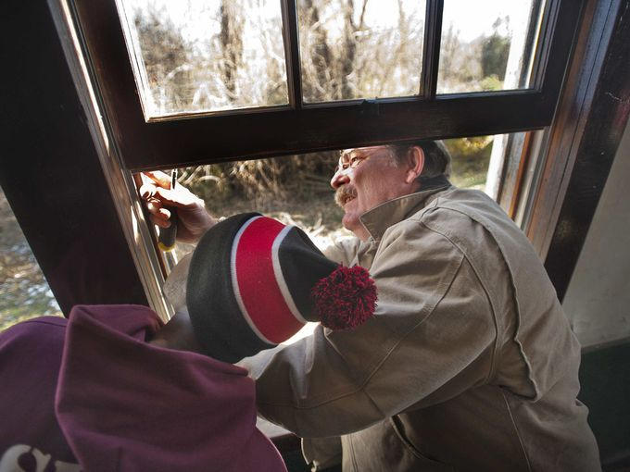
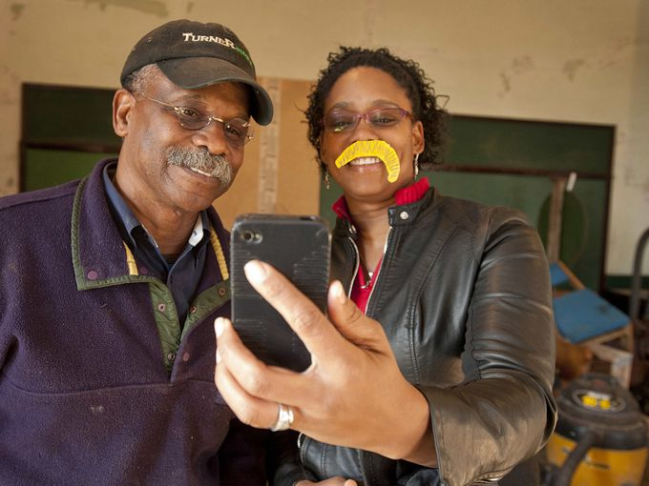
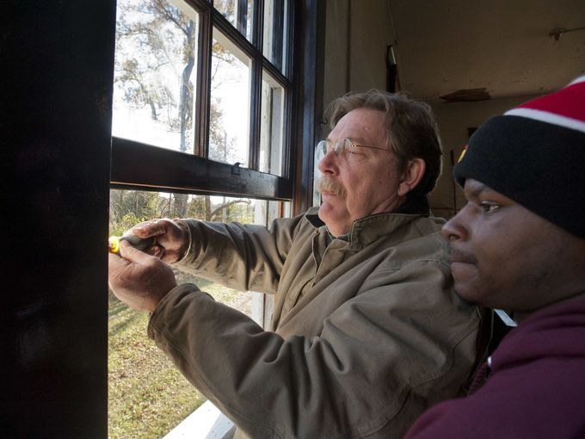
Notes:
Here are some more pics,
See how much fun they’re having?!
Bob and Jim…

Slide 12
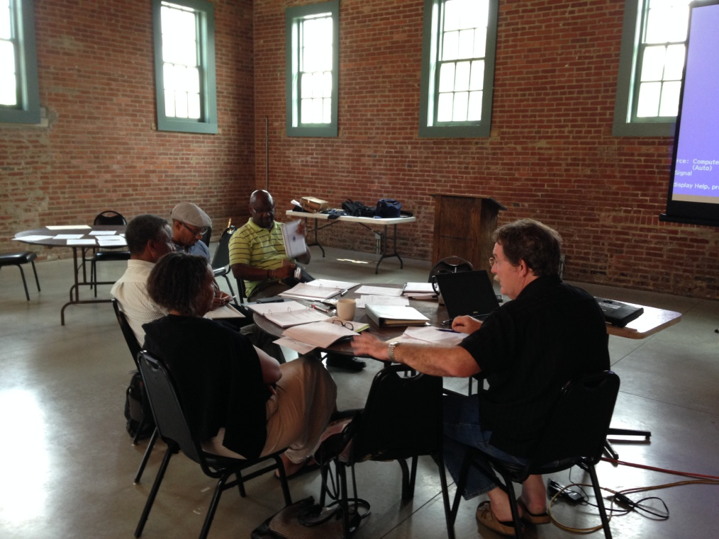
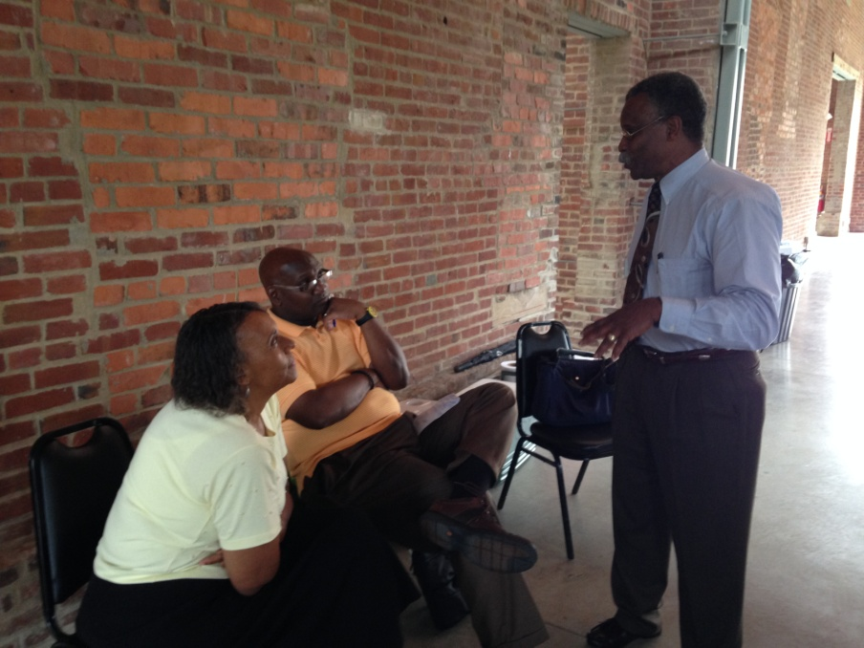
Organizational Structure: Train the Trainer
July 6-10
Finalize Curriculum
Student Enrollment
Relationship Building
Community Engagement
Job Placement
Notes:
Bob Yapp, then took to training the folks that will be leading this program

Slide 13
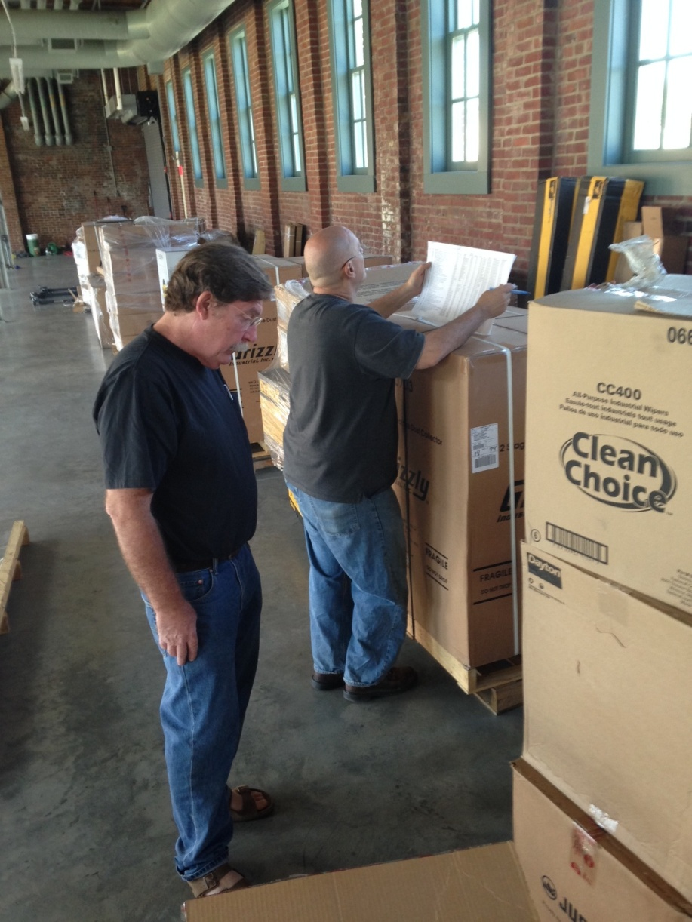
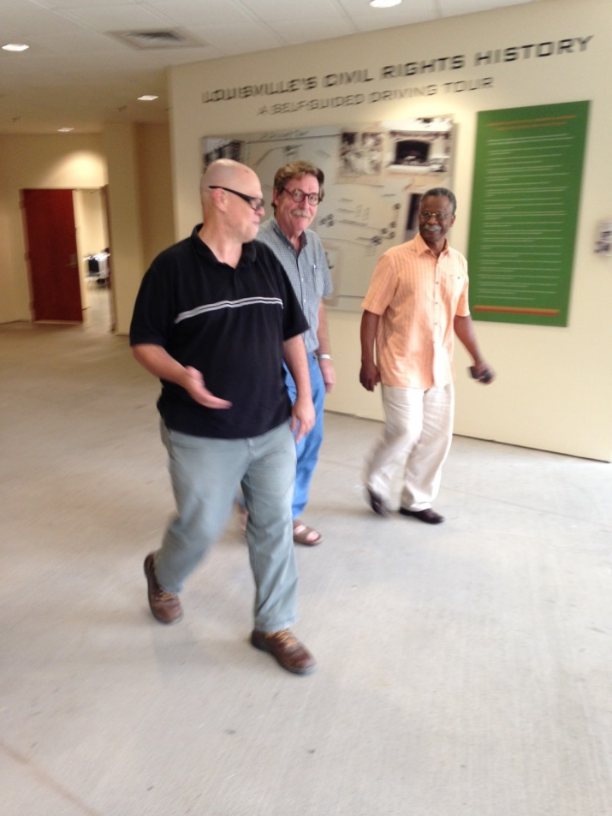
Second Train the Trainer
August 17-21
Notes:
This part is very intensive because it’s not just teaching someone how to repair a historic window. Teaching an interested group isn’t that difficult.
This program is targeted to disadvantaged individuals, underserved economically and educationally. That can sometimes come with some baggage as you can imagine. These instructors are dealing with that in addition to teaching new comers to power tools.

Slide 14
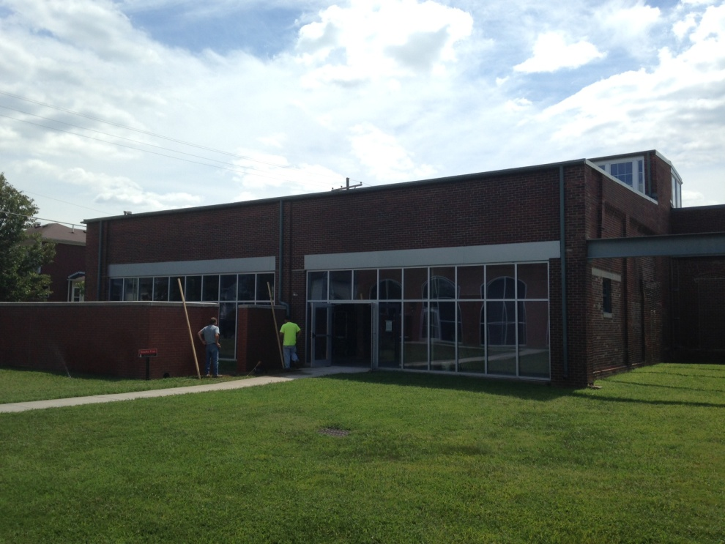
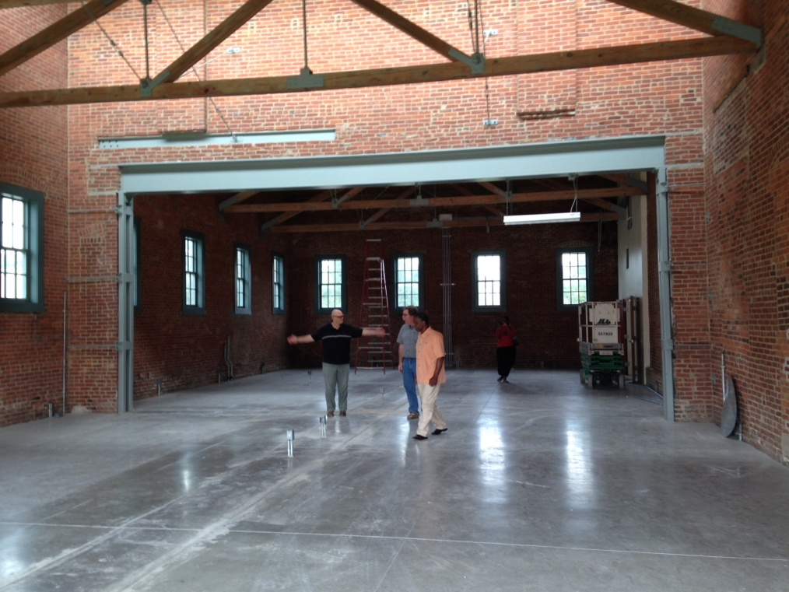
Facility Improvements and Equipment
Notes:
Here is the exterior and interior of Building C where the program is housed.

Slide 15
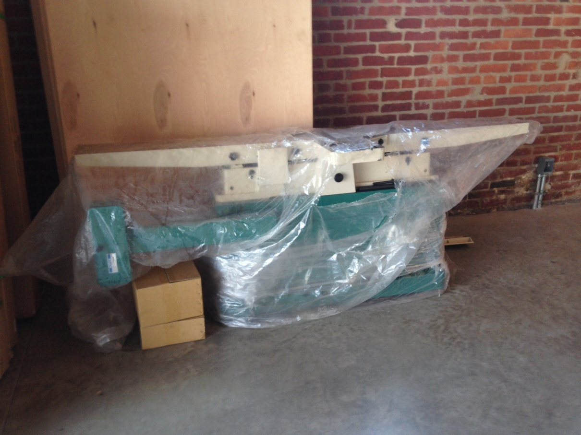
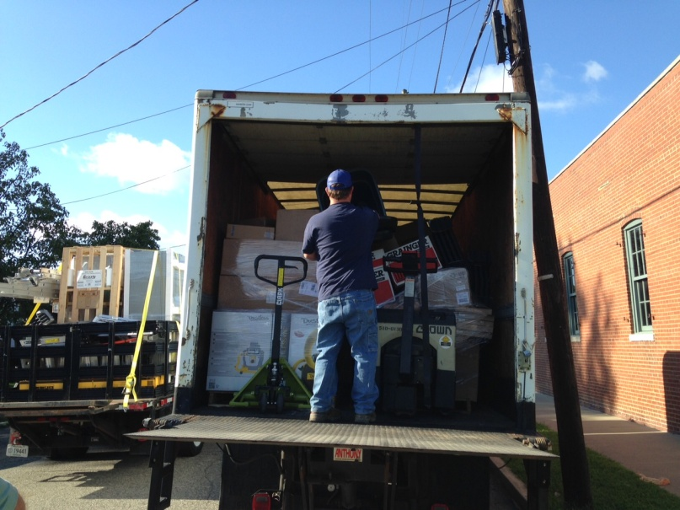
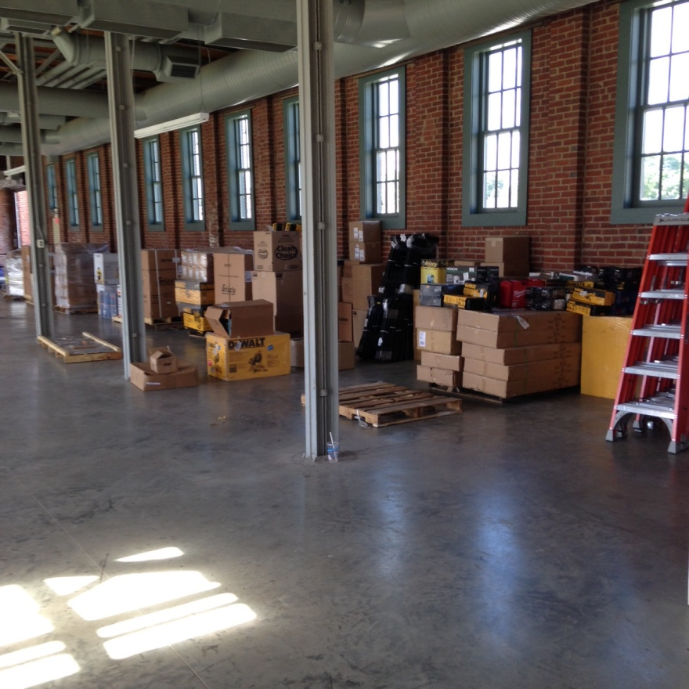
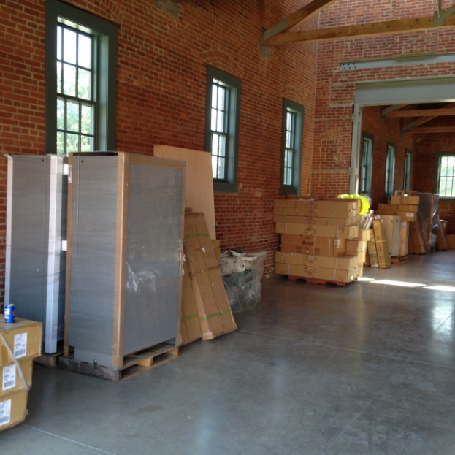
Notes:
We stocked it with lots of specialized, specific equipment

Slide 16
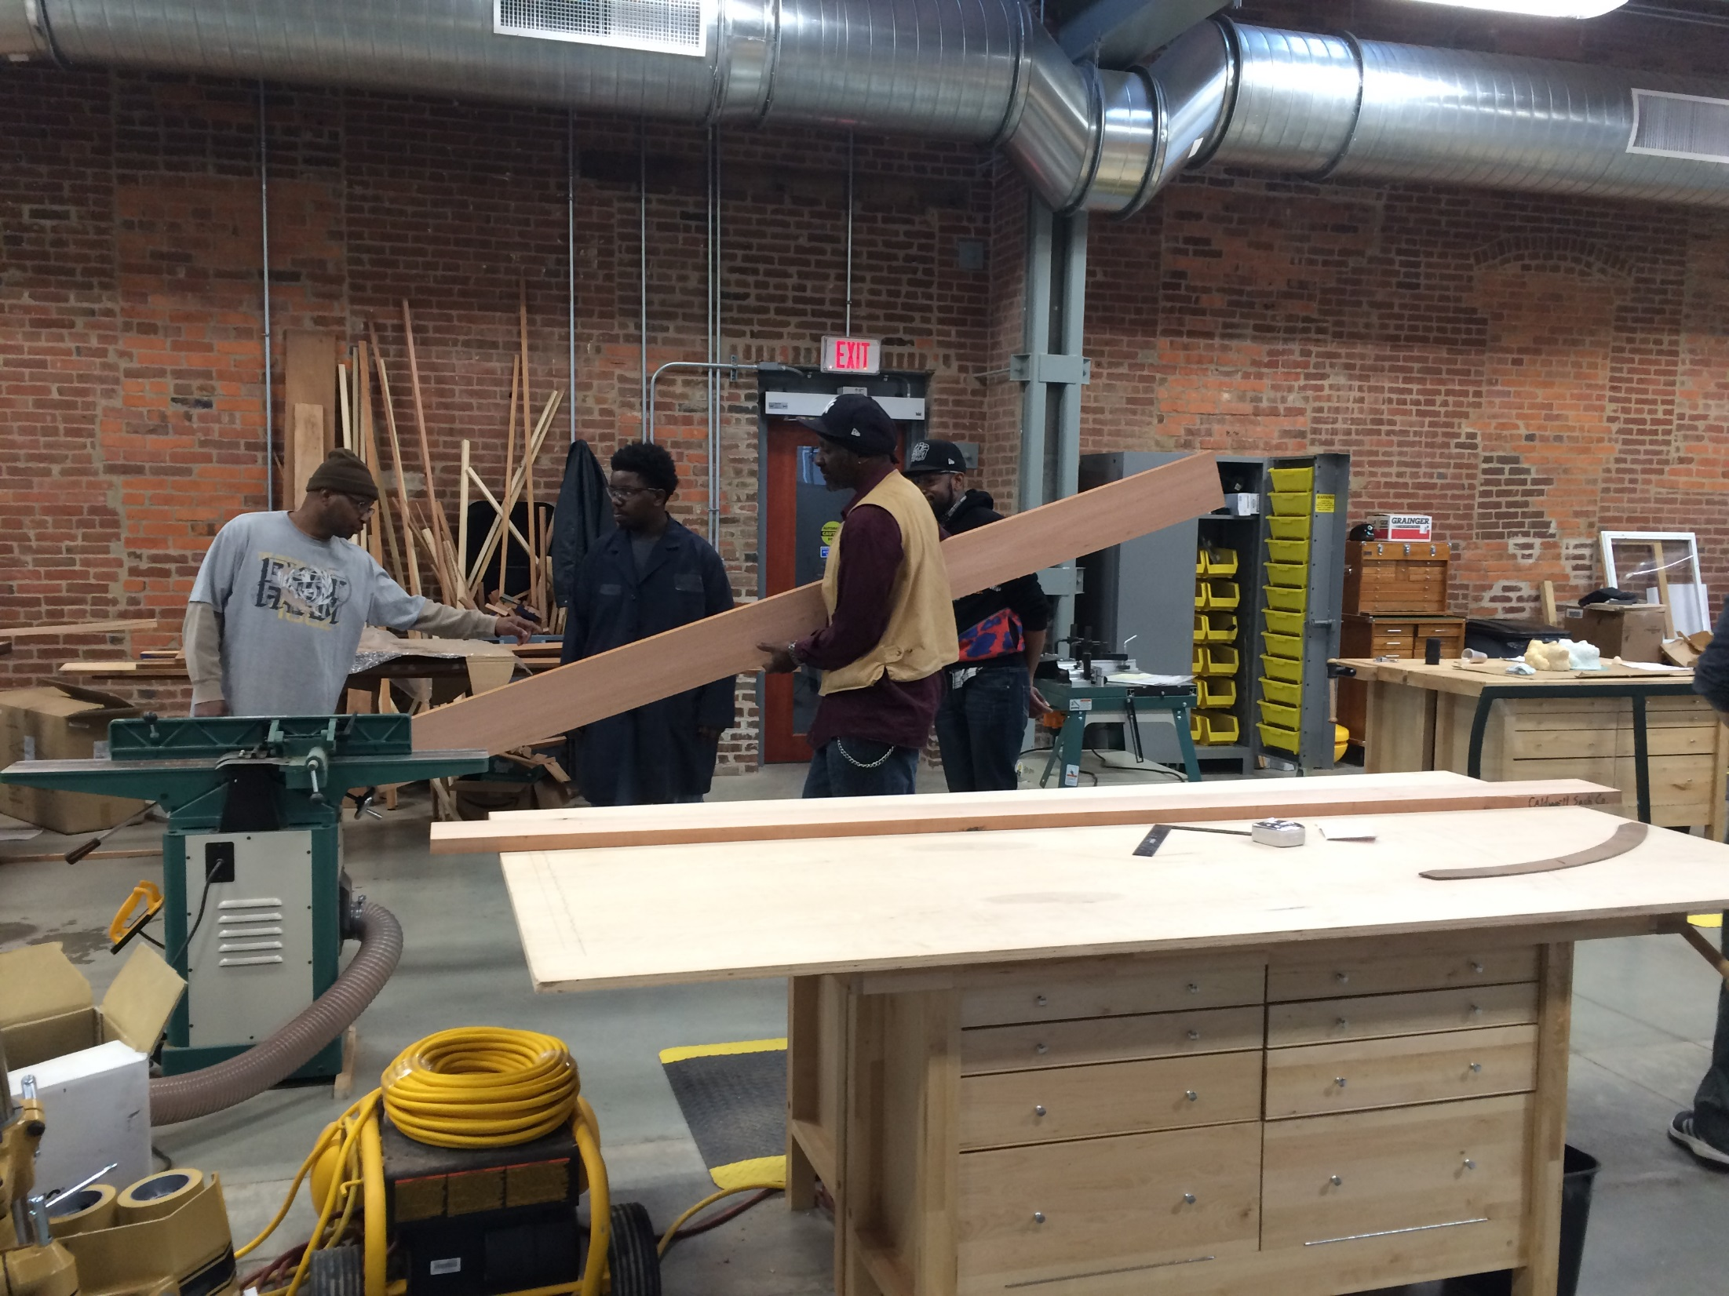
Notes:
I love these benches we bought them
Here’s some guys using the joiner

Slide 17
Starting the Program
Identify our Partners
Identify a Consultant
Identify Stakeholders
Identify Board Members – 501c3 Inc.
Hire Public Outreach/Mentor Position
Create a Certifiable Curriculum
Identify a Program Administrator
Identify a Program Instructor
Identify Students
RFP to Build Out Russell Hall (Building C)
Purchased Shop Equipment
Identified a Project House
Developing a Marketing Plan
Prepare for Program Implementation
Notes:
Starting a program to remain sustainable after the 3 year commitment has been tough.
Here’s just some of the steps…..

Slide 18
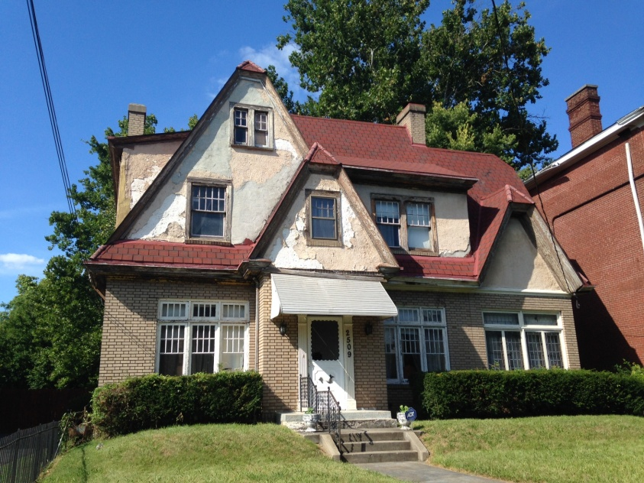
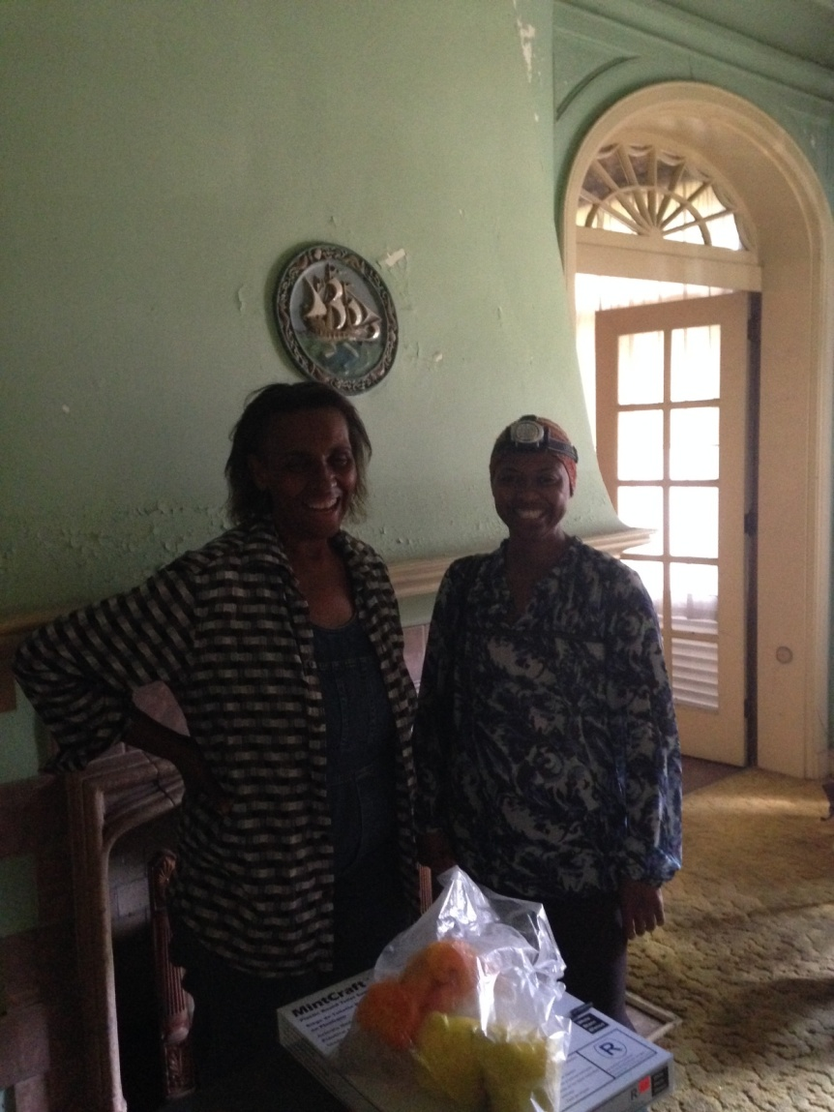
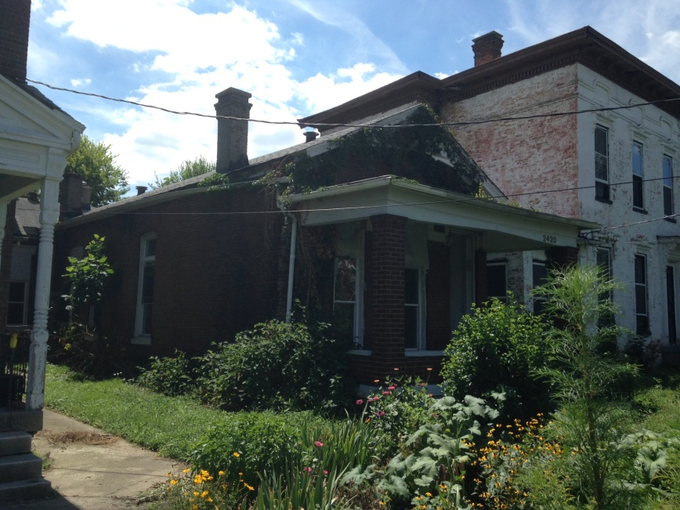
Samuel Plato Academy Foundation, Inc.
Notes:
Perhaps the coolest, coincidental part of it all.
The namesake, Samuel Plato was already chosen…
The first project house was found and procured
Across the street? Plato’s Louisville home that he designed and lived in.
The program is now in discussion of acquiring that vacant home to fix it up. Pretty cool.

Slide 19
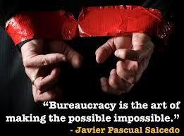
KYTC—Art of the Possible
Challenges
Funding
Building Lease
Purchasing
Personnel
Team Acquisition
We’re overcoming all of them!
Notes:
This program is not with out its challenges
Creating a revenue generating (remember, this is to be sustaining) program from a government office is no fun.
It has taken a lot of creative work to navigate the federal and state procurement process
But we’re overcoming them all.

